Slide 1

2019 WI-CARH Youth Grant Recipients

Slide 2
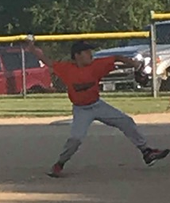
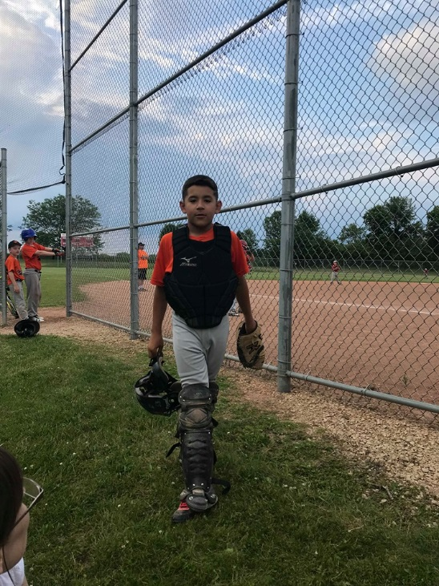
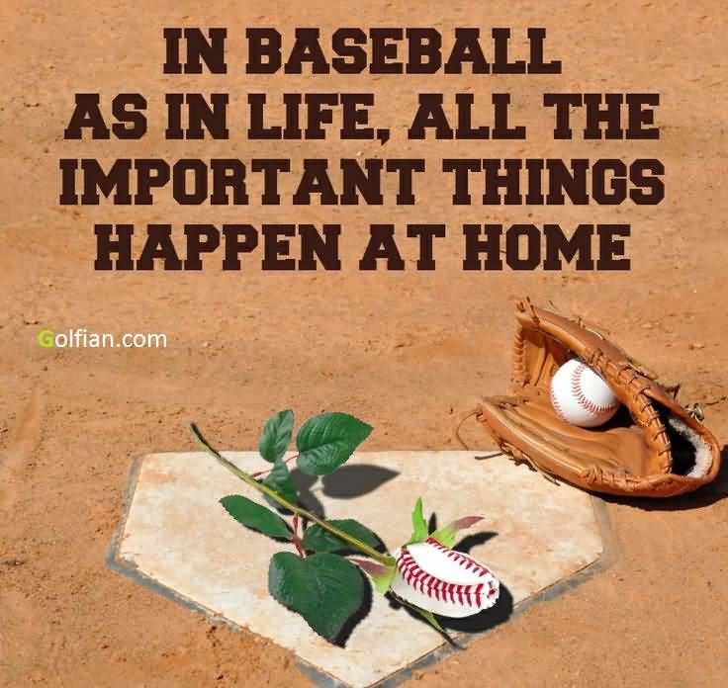

Slide 3
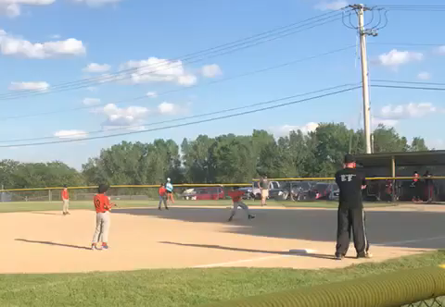
A successful person never loses…..they either win or learn!
Learned to play every position as a team player.
Recipient learned to pitch!

Slide 4
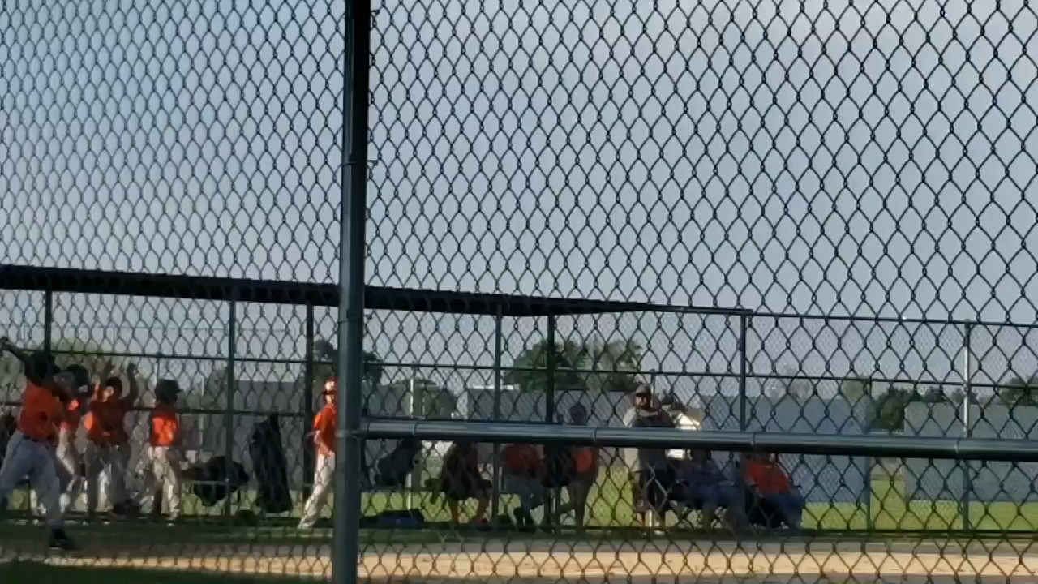
When life throws you a curveball, you hit it out of the park!

Slide 5
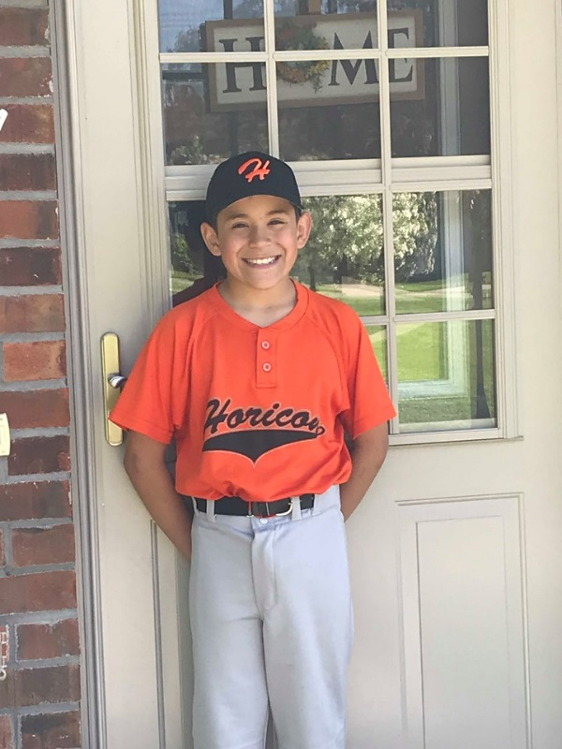
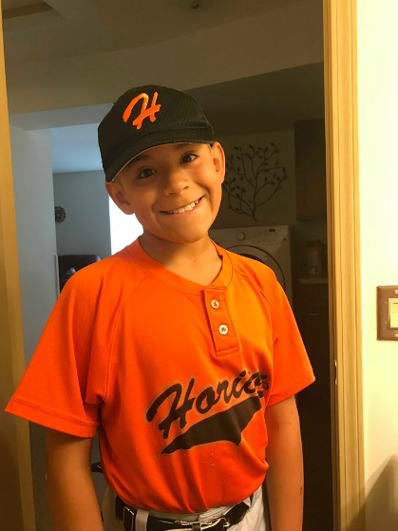
10 year old baseball scholarship recipient
Proud to pose in front of his home.

Slide 6
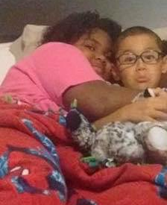
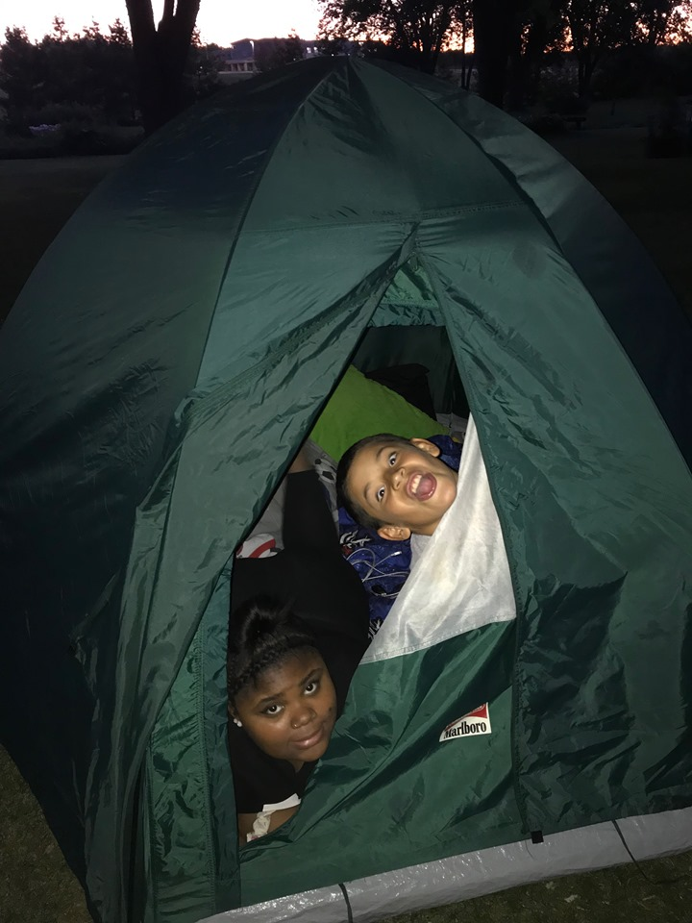
It is the friends we meet along the way that help us appreciate the journey.
2016
2019

Slide 7
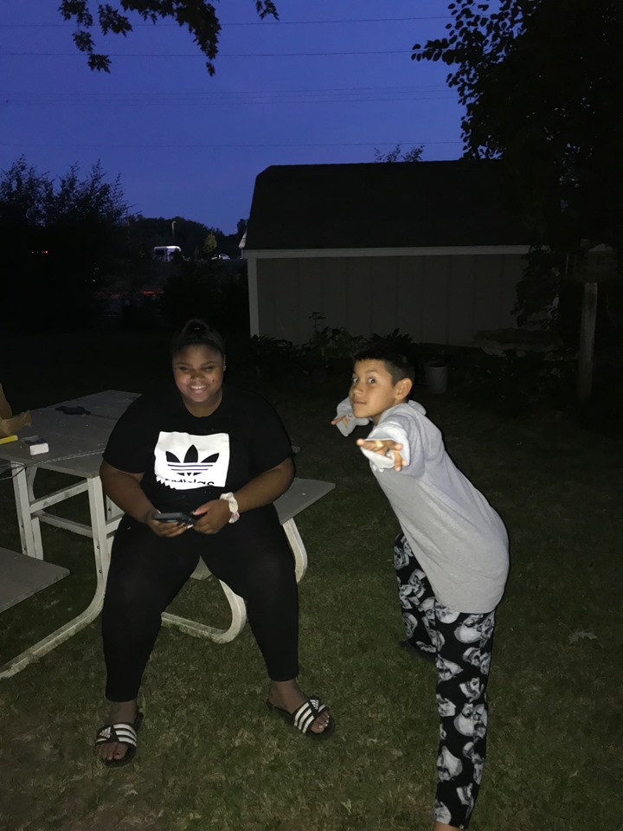
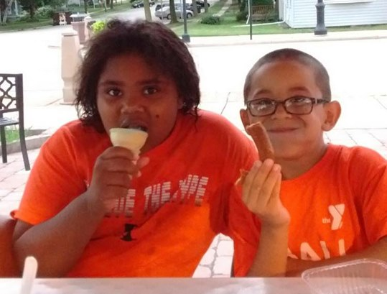
We continue to grow in our journey thanks to your support.
2016
2019

Slide 8
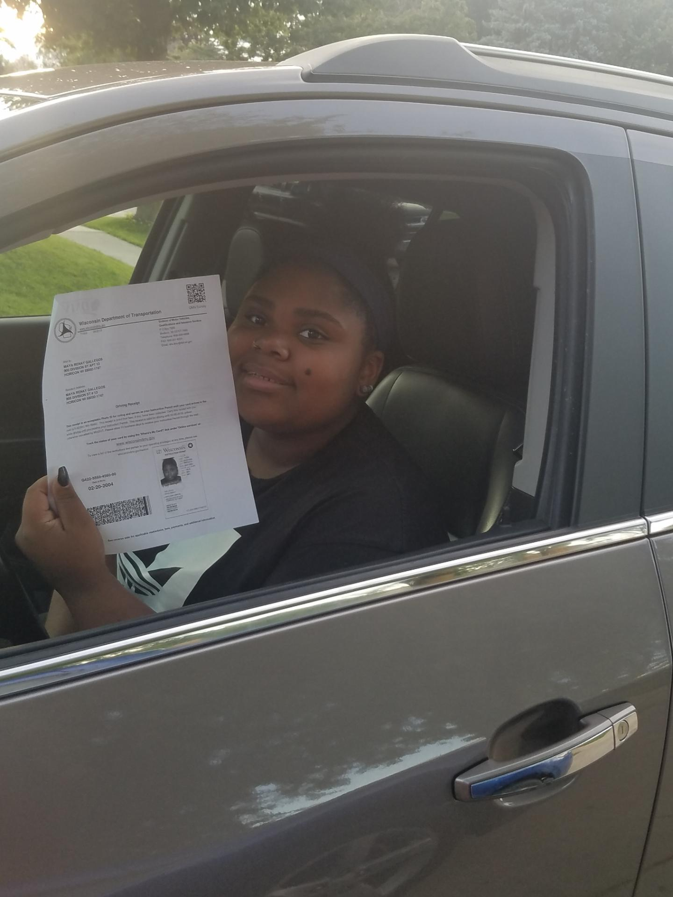

Recipient took Drivers Education classes with the help of the youth grant
Proud to show off her Temps!

Slide 9

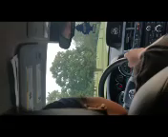
“Always focus on the front windshield and not the rear view mirror.”

Slide 10


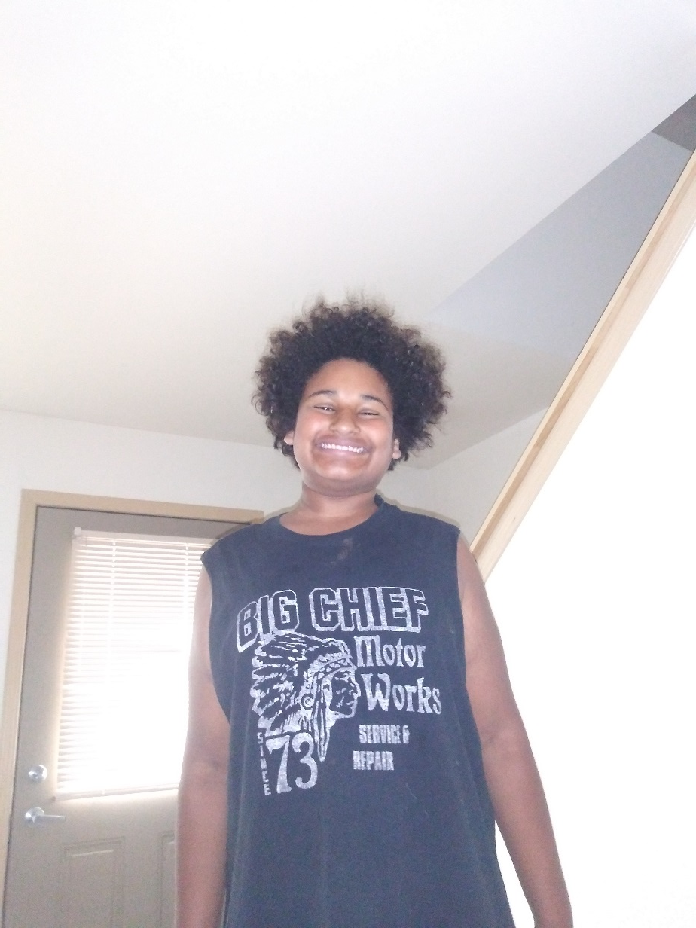


Wisconsin summers are best spent at the city pool
New to the community, Recipient received a pool pass
and made new friends.

Slide 11
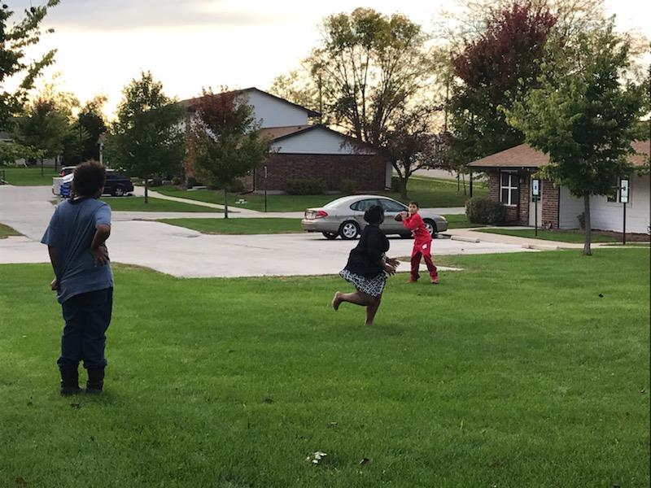
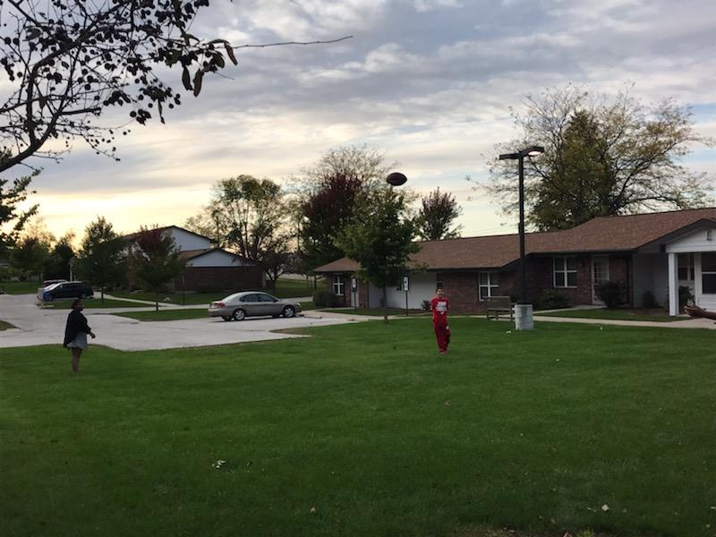
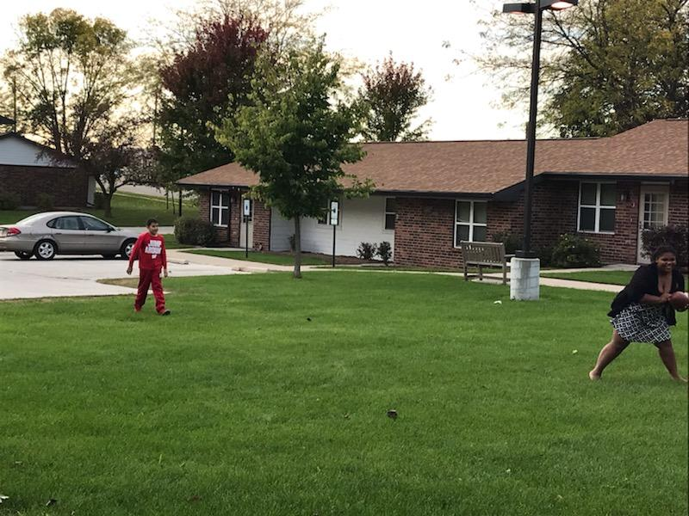
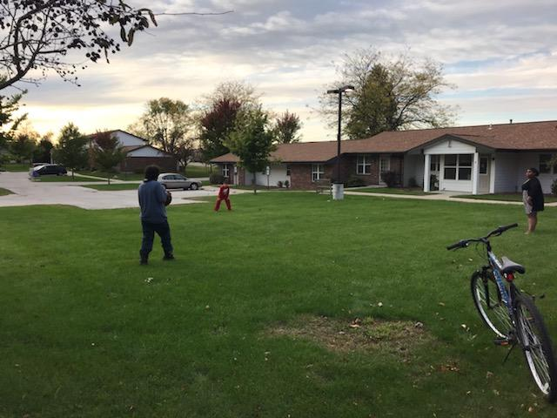
Neighbors…
And Friends

Slide 12
Thank you!

