Slide 1
Smoking by those with a mental illness or other substance use disorder
Clear Gains
Bruce Christiansen, PhD
June 21, 2016

Slide 2
Approach – Avoidance Conflict

Slide 3
Avoidance

Slide 4
Approach
Follow the data

Slide 5
Approach
Typical tobacco control tools:
Clean air acts to protect others from second hand smoke and de-normalize smoking
Taxation to increase the cost to consumers
Advertising/marketing restrictions to de-normalize smoking
Minimum sales age
Wide access to barrier-free, effective tobacco dependence treatments access

Slide 6
Approach
Information about smokers who have a mental illness or other addiction

Slide 7
Approach
Behavioral Health:
Those with a mental illness
Those with a substance abuse (use) disorder in addition to tobacco dependence disorder
AODA – Alcohol or other Drug Addiction

Slide 8
Approach
There are a lot of smokers in the behavioral health population

Slide 9
Smoking Prevalence Among Adults 18 and Older, United States, 1965-2013
2013 = 17.8%
Source: NHIS
Notes:
- Start by describing
- End with Impact
The research finding that solves a problem that touches few people - say the cure for an incredibly rare disease – will probably have less policy interest and impact than even minimal program on a common disease.
In the case of tobacco…
small changes BIG IMPACT
Back to the epidemiology of tobacco use.

Slide 10
The Emergence of Tobacco Disparities

Slide 11
Statistics You Need to Know
Very elevated prevalence

Slide 12
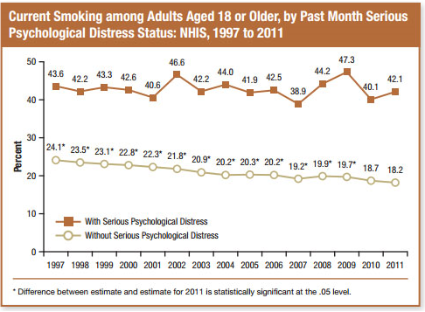

Slide 13
Tobacco Use by Diagnosis
Schizophrenia | 62-90%
Bipolar disorder | 51-70%
Major depression | 36-80%
Anxiety disorders | 32-60%
Post-traumatic stress disorder | 45-60%
Attention deficit/ hyperactivity disorder | 38-42%
Alcohol abuse | 34-80%
Other drug abuse | 49-98%
(Beckham et al., 1995; De Leon et al., 1995; Grant et al., 2004; Hughes et al., 1986; Lasser et al., 2000; Morris et al., 2006; Pomerleaue et al., 1995; Stark & Campbell, 1993; Ziedonis et al., 1994)

Slide 14
Prevalence
Adapted from Lasser, 2000

Slide 15
Statistics You Need to Know
Very elevated prevalence
This mental illness tobacco gap is getting larger, not smaller

Slide 16
Trends in Smoking Among Adults with Mental Illness and Association Between Mental Health Treatment and Smoking Cessation Cook et. al. JAMA 2014; 311(2): 172-182

Slide 17
Statistics You Need to Know
Very elevated prevalence
This mental mllness tobacco gap is getting larger, not smaller
Those with mental illness/SUD consume about 40% of all cigarettes

Slide 18
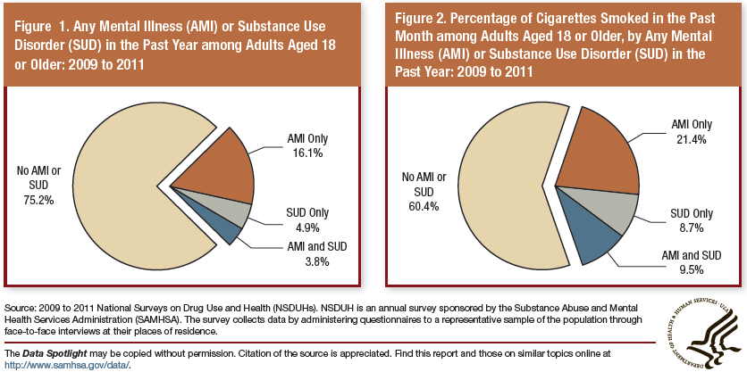

Slide 19
Not only is smoking prevalence high….
Smoke greater amounts
Shorter time between puffs
More puffs/cigarette
Smoke more of the cigarette
Greater nicotine boost
Greater dependence/addiction at lower daily amount

Slide 20
Approach
There are a lot of smokers in the behavioral health population
A terrible health price is paid

Slide 21
People who have a mental illness die about 20 - 24 years before those who do not

Slide 22
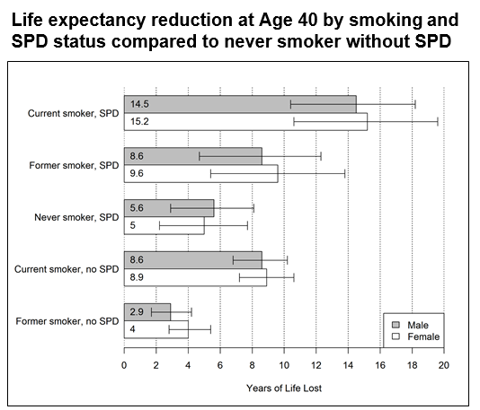
SPD: Serious Psychological Distress, National Health Interview Survey

Slide 23
Est. 200,00 per year for those with mental illness/SA

Slide 24
Approach
There are a lot of smokers in the behavioral health population
A terrible health price is paid
“We” have a special obligation to help this population

Slide 27
22% of mental health consumers who smoke report that they started while hospitalized

Slide 28
Approach
There are a lot of smokers in the behavioral health population
A terrible health price is paid
“We” have a special obligation to help this population
?These smokers don’t want to quit?

Slide 29
83.1% of smokers have tried to quit
46.7% said this was a good time to quit
-----------------------------------------------------
Serious quit attempt: 71%
Average number of quit attempts: 6
Reduced smoking in past year: 53%

Slide 30
1,470 Smokers Seeking Treatment in a Randomized Clinical Trial
Excludes smokers who use MAOIs, bupropion, lithium, antipsychotics; history of psychosis, bipolar disorder, eating disorder; consume 6 or more alcoholic beverages daily 6 or 7 days a week
Piper, et. al. Psychiatric Disorders in Smokers Seeking Treatment for Tobacco Dependence: Relations with Tobacco Dependence and Cessation, 2010, JCCP, 78(1) 13-23

Slide 31
Approach
There are a lot of smokers in the behavioral health population
A terrible health price is paid
“We” have a special obligation to help this population
?These smokers don’t want to quit?
?These smokers can’t/won’t quit?

Slide 32
63.5% have known consumers like themselves who have quit

Slide 33
National Epidemiological Survey on Alcohol and Related Conditions (NESARC)
Quit rate among smokers with no mental illness: 22.3%
Quit rate among smokers with any mental illness: 18.5%
Quit rate among smokers with psychosis: 12.5%

Slide 34
Approach
There are a lot of smokers in the behavioral health population
A terrible health price is paid
“We” have a special obligation to help this population
?These smokers don’t want to quit?
?These smokers can’t/won’t quit?
?Quitting causes harm?

Slide 35
Trying to quit will harm my patient.
Undue the progress we’ve made
De-stabilize the patient
Lead to relapse
Now is not the time; we’ll do it later when … patient is more stable, there is less stress, etc.
Tobacco addiction is not as important as what I’m treating
Smoking is their only pleasurable activity
Smoking is the only thing they control in their lives
They will become disruptive if they are coerced to quit

Slide 36
Quitting delivers great benefits
A meta-analysis of 19 studies found that providing smoking cessation interventions during addictions treatment was associated with a 25% greater likelihood of long-term abstinence from alcohol and illicit drugs. Contrary to concerns, smoking cessation interventions during addictions treatment appears to enhance rather than compromise long-term sobriety. (Abstinence from smoking was far more modest.)
Procheska, Delucchi, and Hall, (2004) A Meta-Analysis of Smoking Cessation Interventions with Individuals in Substance Abuse Treatment or Recovery. Journal of Consulting and Clinical Psychology 72(6) 1144-1156

Slide 37
Quitting delivers great benefits
A meta-analysis found that compared to those that did not quit, those that did experienced significant improvements in depression and anxiety and significant reductions in stress.
The amount of reduction in anxiety and depression was equal to or bigger than what would have been expected from medications used to treat anxiety and depression.
Taylor, McNeil, Girling, Farley, Linson-Hawley, Avegard “Change in Mental Health after Smoking Cessation: Systematic Review and Meta-analysis” BMJ 2014; 358:g1151

Slide 38
Effect of Smoking Cessation on Mental Health
Taylor, McNeil, Girling, Farley, Linson-Hawley, Avegard “Change in Mental Health after Smoking Cessation: Systematic Review and Meta-analysis” BMJ 2014; 358:g1151
Populations: general (14), chronic physical condition (3), pregnant women (2), postoperative (1), either chronic condition and/or psychiatric condition (2), psychiatric condition (4)
Outcome | # of studies | Effect estimate (95% CI)
Anxiety | 4 | -0.37 (-0.70 to -0.03)
Depression | 9 | -0.29 (-0.42 to -0.15)
Mixed anxiety and depression | 4 | -0.36 (-0.58 to -0.14)
Psychological quality of life | 4 | 0.17 (-0.02 to 0.35)
Positive affect | 1 | 0.68 (0.24 to 1.12)
Stress | 2 | -0.23 (-0.39 to -0.07)

Slide 39
Dilemma

Slide 40
Dilemma
Vs. High prevalence
High health consequences
Desire to Quit
Ability to quit
Great benefits from quitting

Slide 41
Resolution and Recommendation

Slide 42
Recovery Movement:
Include residents in the solution

Slide 43
For more information….
www.ctri.wisc.edu
bc1@ctri.wisc.edu

Slide 45
Questions?

