Slide 1
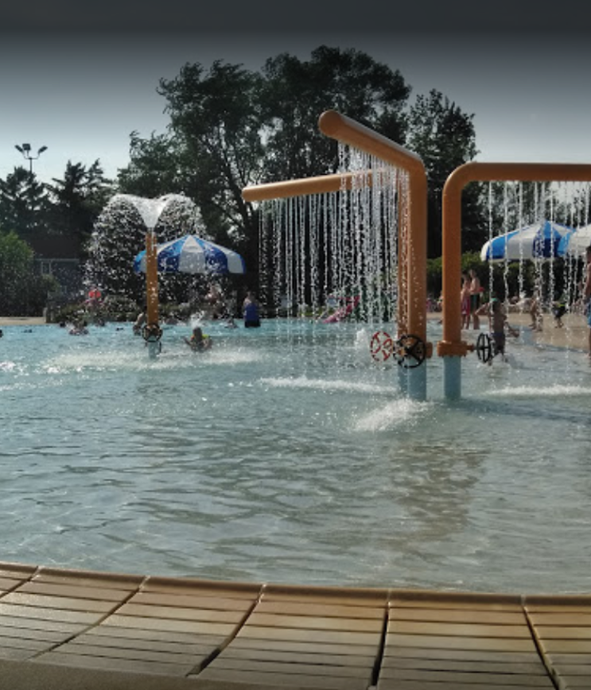
Thank you!
From the 2018 Scholarship Winners

Slide 2
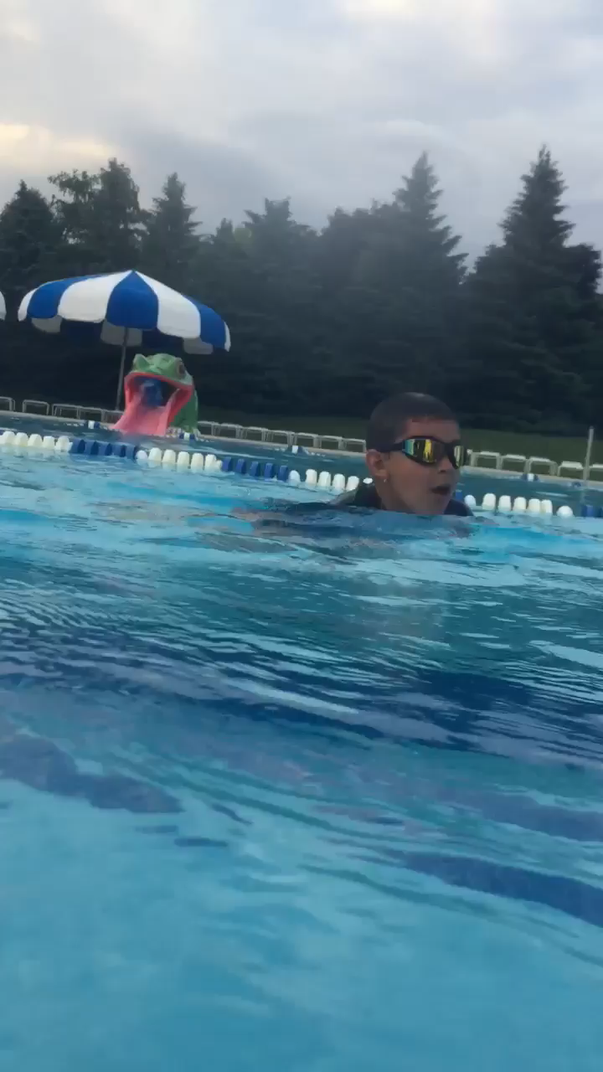
We dove right into summer with your help!

Slide 3
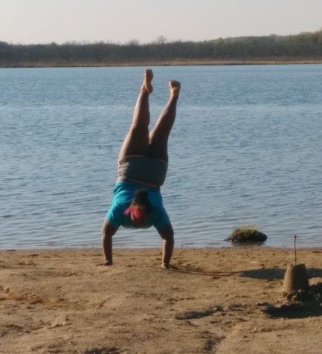
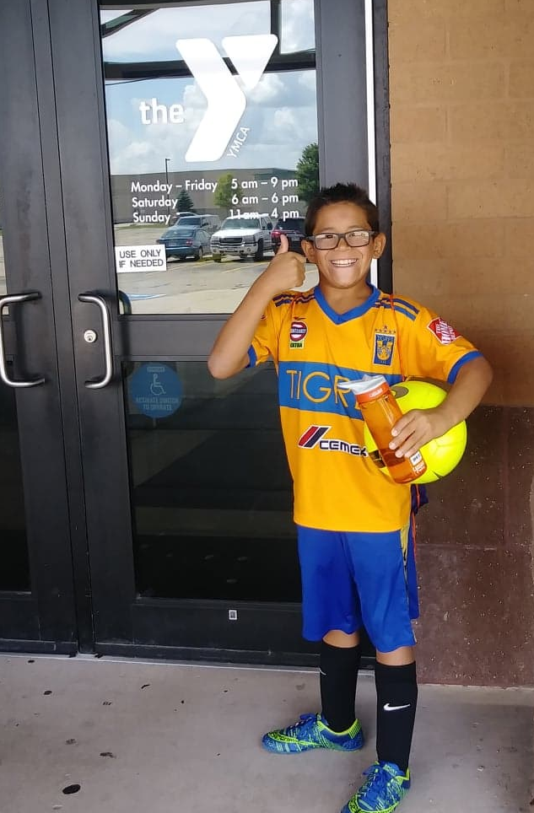
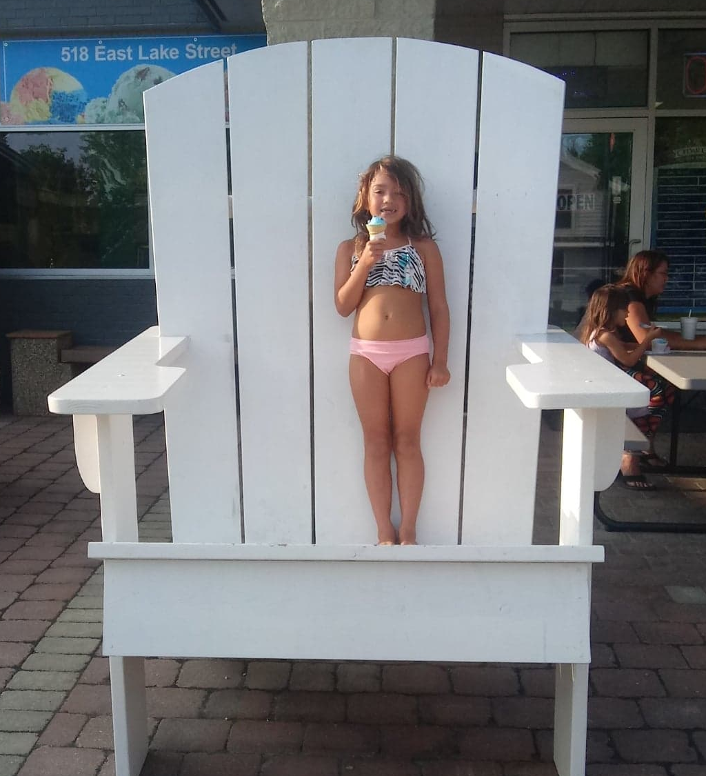
Scholarship Winners having a fun summer!

Slide 4
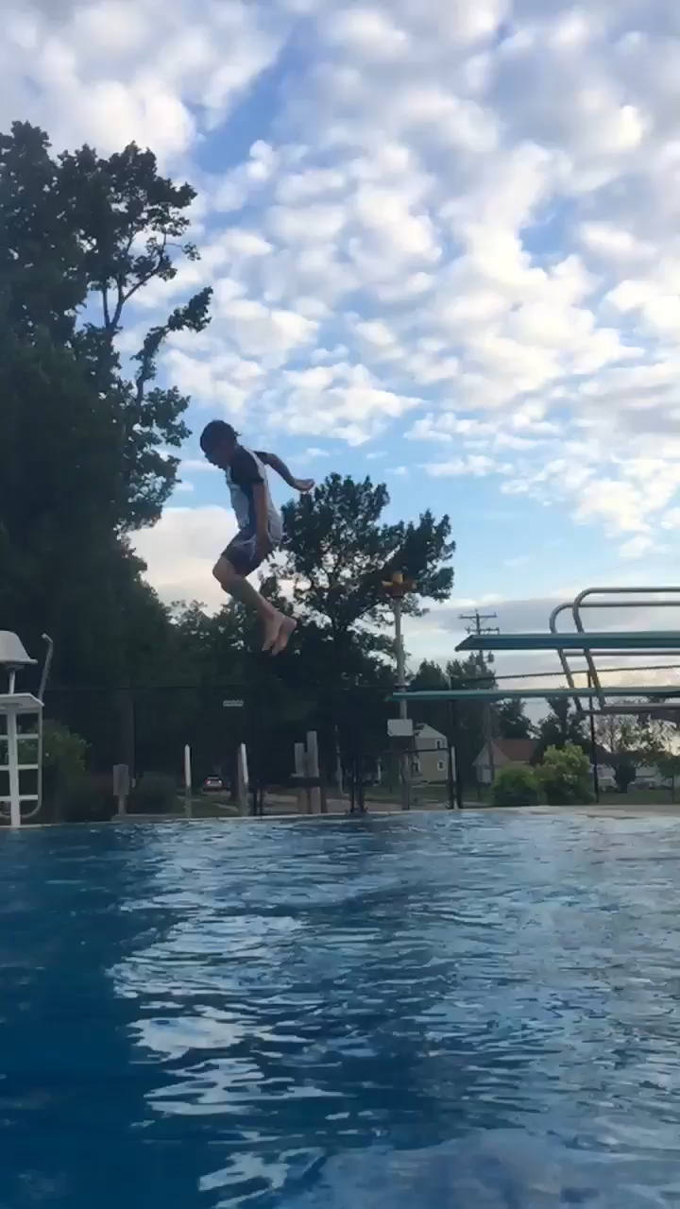
We kept jumping all summer!
Filmed by Recipient age 14 Jumping by recipient age 9

Slide 5

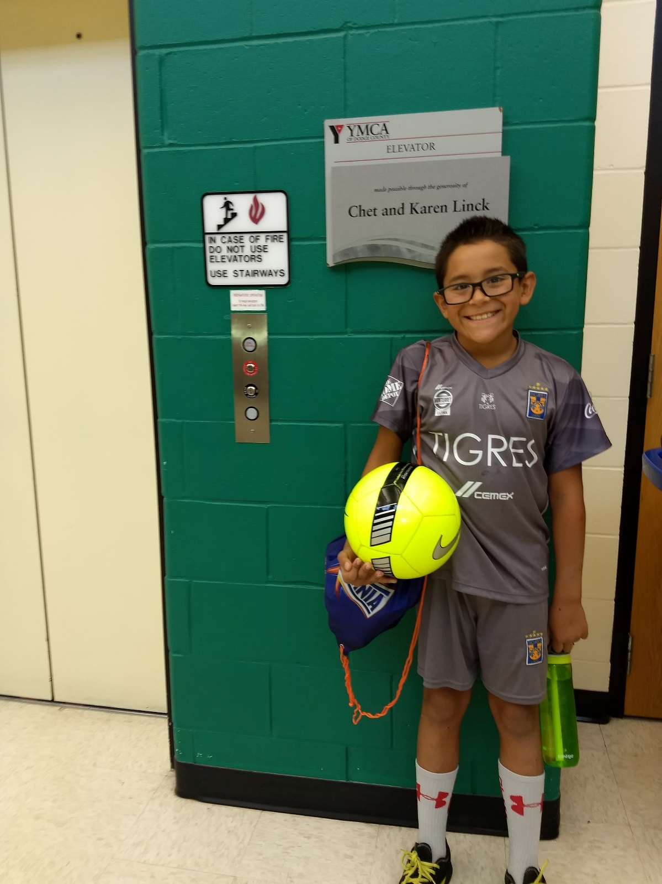
We stayed active!
“Soccer camp was awesome”- Recipient - 9 years old

Slide 6
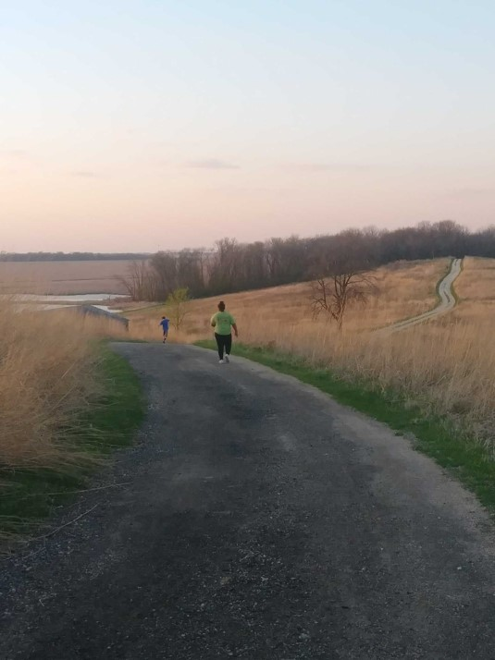
The road to a friends house is never long
Thank you for bringing us together this summer

Slide 7
For more information about WI-CARH’s Scholarship program, please visit www.wicarh.org
email info@wicarh.org
or contact your property manager
Scholarships are available for but not limited to: 4H Camp; Music or Band Camp; Sports Camp; Cheerleading Camp; Girl Scout or Boy Scout Camp; International Youth Exchange Program, or to allow a student to accompany their class to a foreign country or other school sponsored trips.

